Slide 1
APUSH Review: Pools, Integrations, and Interlocking Directorates!
Everything You Need To Know About Business Practices To Succeed In APUSH

Slide 2
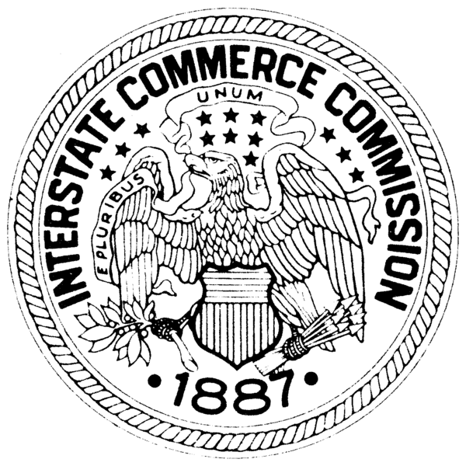
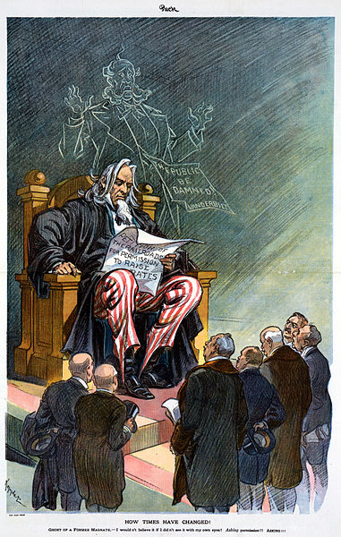
Pools!
What is it?
Firms agreed to divide an area amongst themselves
Share in the profits
Used by Railroads
Outlawed by the Interstate Commerce Act (1887)

Slide 3
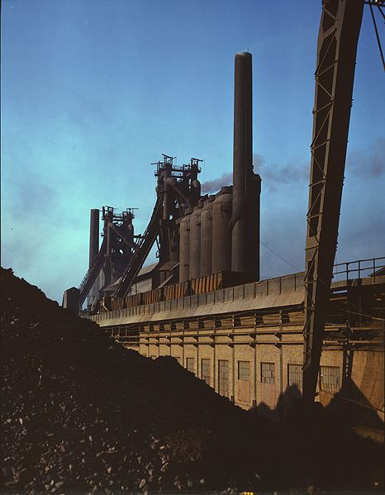
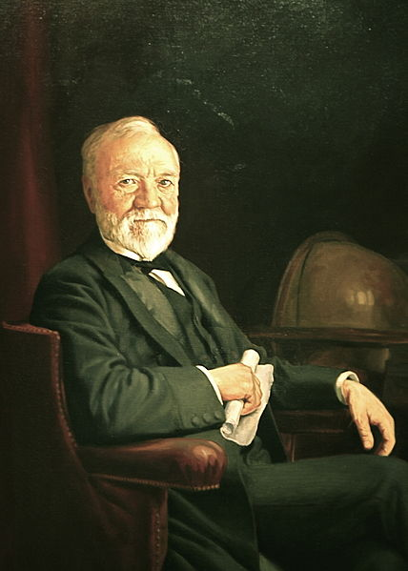
Vertical integration!
Made popular by Andrew Carnegie and his steel company
What is vertical integration?
When a business controls ALL aspects of production
Example
Carnegie Steel – Controlled production from beginning to the end
Why was this used?
Reduce costs, keep everything “in house”
Was this legal?
Yes!

Slide 4

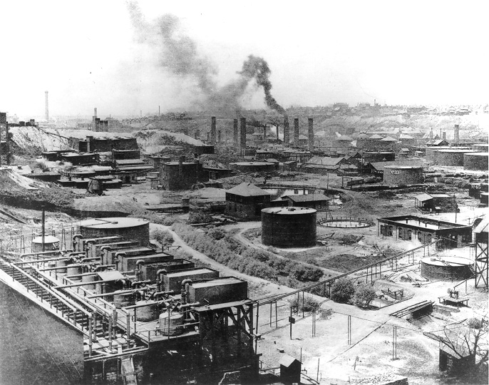
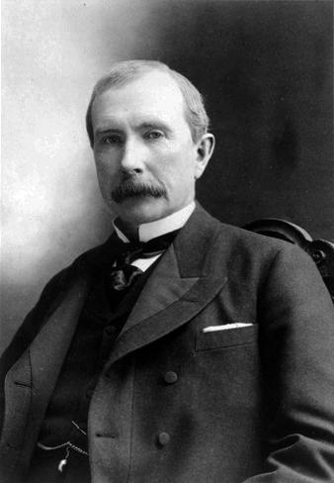
Horizontal integration!
Popularized by John D. Rockefeller and his Standard Oil Company
What is it?
All businesses within an industry join together and create a monopoly
Example:
Rockefeller’s Standard Oil
Controlled most of the oil industry at one time
Was this legal?
Eventually, no!

Slide 5
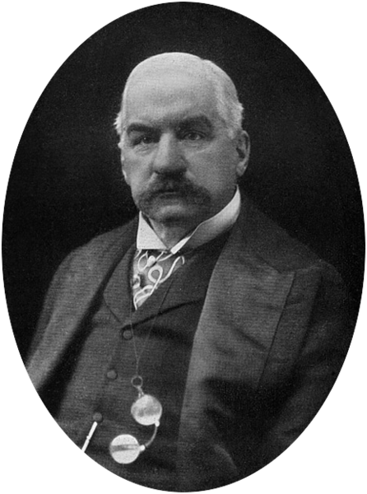
Interlocking Directorates
Popularized by J.P. Morgan
What are interlocking directorates?
When a board of director serves on the board of multiple, competing, companies
Example
JP Morgan and the banking industry
Why was this used?
Can control multiple businesses in the same industry
Was this legal?
Clayton Antitrust Act prohibited this in the same industries

Slide 6
Thanks for watching!
Subscribe to my channel
Help spread the word
Questions? Comments? Ideas for videos?
Leave in comments
It’s not illegal to subscribe…..
Subscribe
Down here!

